Slide 1
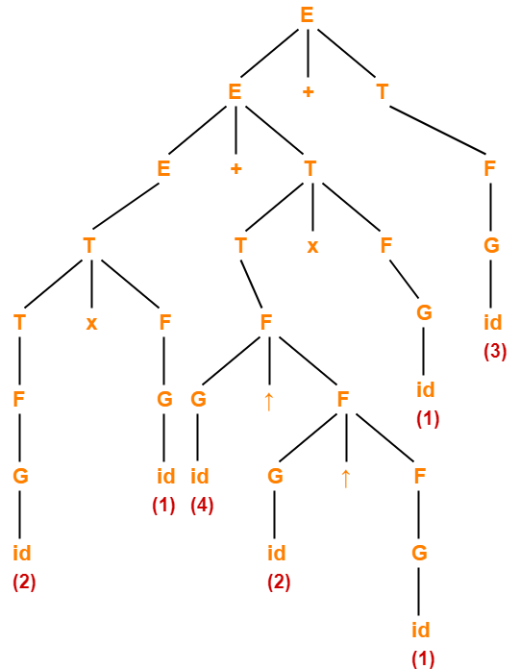
THE SEMANTICS OF CONTEXT-FREE
LANGUAGE

Slide 2
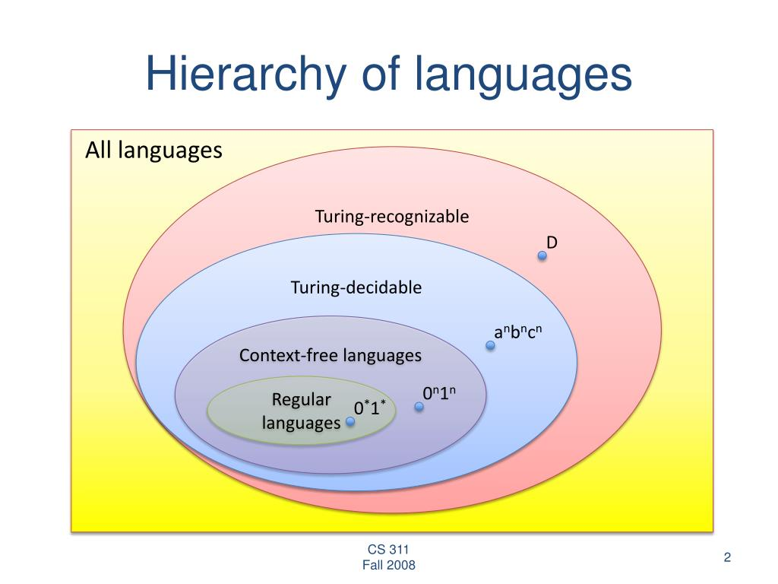

Slide 3
S -> A | b
A -> CC
C -> D | a
D -> d
da -> DC
DC -> CC
CC -> A
A -> S
A SAMPLE CONTEXT-FREE GRAMMAR

Slide 4
S
|
A
|
AA
/ \
AA a
/ \
a a
S -> A | B
A -> a | AA
B -> b | BB
A SAMPLE CONTEXT-FREE GRAMMAR

Slide 5
APPLICATION

Slide 6
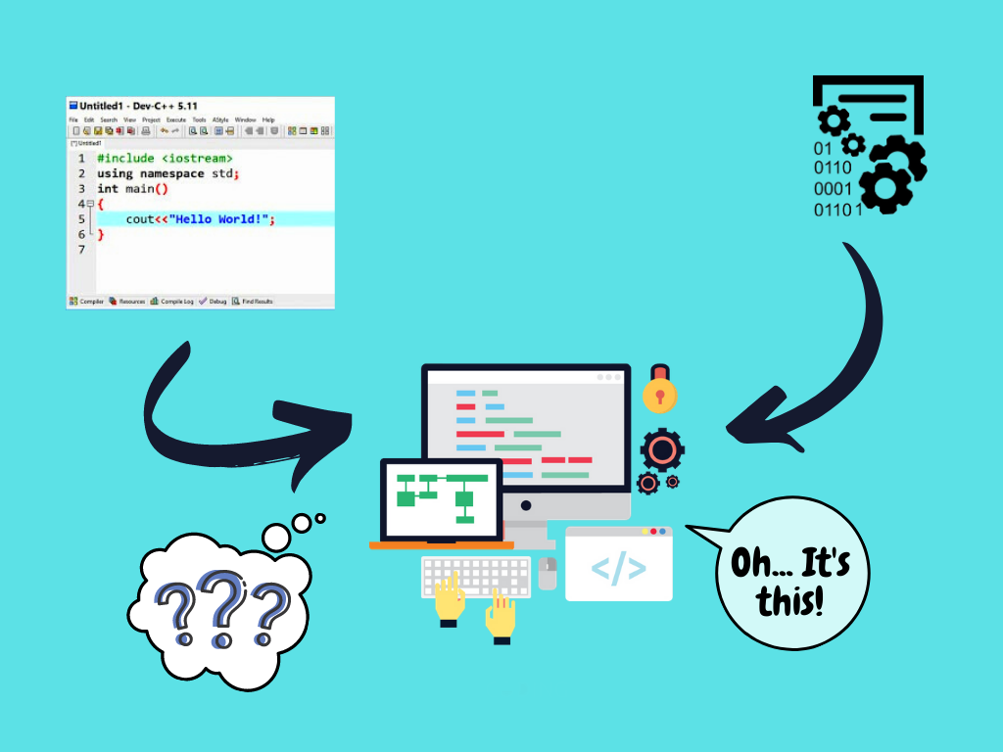

Slide 7
PARSING A SAMPLE FUNCTION
int add(int a, int b) {
return a + b;
}

Slide 8
LIST OF TOKENS
Keyword: int
Identifier: add
Punctuation: (
Keyword: int
Identifier: a
Punctuation: ,
Keyword: int
Identifier: b
Punctuation: )
….
int add(int a, int b) {
return a + b;
}

Slide 9
ABSTRACT SYNTAX TREE
└─── FunctionDefinition: int add(int a, int b)
│
├─── Declaration: int
│ └─── Identifier: a
│
├─── Declaration: int
│ └─── Identifier: b
│
└─── CompoundStatement: {
└─── ReturnStatement: return
└─── BinaryExpression: a + b
├─── Identifier: a
└─── AdditionOperator: +
└─── Identifier: b

Slide 10
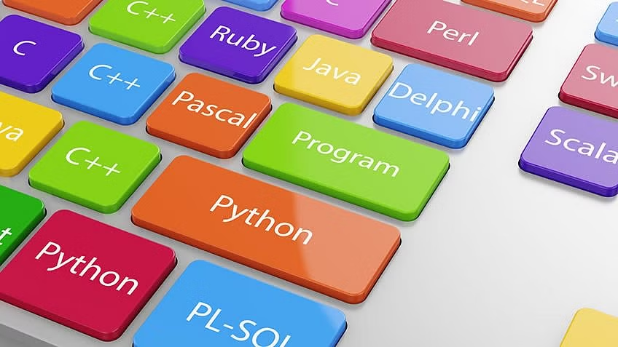
WHICH LANGUAGES WORK IN THIS WAY?

Slide 11
Will you ever need Context-free Languages in your life?

Slide 12


Slide 13
Bibliography
ANSI C yacc grammar. ANSI C grammar (Yacc). (n.d.). Retrieved February 25, 2023, from https://www.quut.com/c/ANSI-C-grammar-y.html
Tools for your java code. JavaParser. (n.d.). Retrieved February 25, 2023, from https://javaparser.org/
Lutkevich, B. (2022, July 7). What is a parser? definition, types and examples. App Architecture. Retrieved February 25, 2023, from https://www.techtarget.com/searchapparchitecture/definition/parser

